Slide 1


BiographyPresentation
Shakuntala Devi
By:
Raghav Maheshwari
PA55

Slide 2
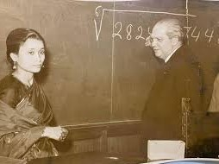

Who was Shakuntala Devi?
Shakuntala Devi was born on 4th November 1929 in Bangalore, Karnataka. She had unparalleled talent in calculating complex mathematical numbers. She
proved her exceptional talent in arithmetic maths through her math shows worldwide at a very tender age.Her excellent skill has brought her a renowned name as “Human-Computer.”

Slide 3

The early life of the mathematical prodigy
Shakuntala Devi’s parents lived in Bangalore and belonged to a Kannada Brahmins community. At the tender age of 3, Devi’s father, Mr. Sudhararaja Rao, discovered her mathematical talent during a card trick. Later, he has also taken Devi for roadshows to demonstrate her mathematical skills in schools and colleges.
At the age of 6, Devi has performed her arithmetic skills at the University of Mysore. She has achieved all these without any formal education. Thus, her tours to different parts of the world began and made her a world-famous Indian mathematician.
Devi’s greatest passion for calculating complex numbers has taken her to many unique places around the globe. She demonstrated her arithmetic abilities before many students and motivated young minds to discover mathematics’s beauty and simplicity.

Slide 4
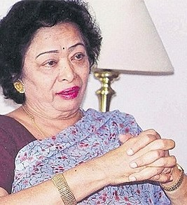
Career:
In 1944, Shakuntala became an international name and travelled to several countries including the United States of America, Hong Kong, Japan, Italy, Russia , Canada, France,
Spain, Malaysia demonstrating her expertise in mathematics.
She was also a successful astrologer and wrote many books. She has also written many texts on mathematics for children, puzzles, cookbooks
and novels.
Shakuntala was also an active philanthropist. She started Shakuntala Devi Education
Foundation Public Trust to provide an excellent education to underprivileged children. She has also worked to spread global awareness about
India's contribution to Mathematics.

Slide 5



Achievements
Shakuntala Devi won the 'Distinguished Woman of the year
Award' in 1969, from University of
Philippines along with a gold medal.
Her name was listed in the '1995 Guinness Book of
World Records' edition for her outstanding mathematical feat where she beat the world's fastest computer at multiplying two thriteen
digit numbers.
In 1988, she was honored with the 'Ramanujan Mathematical
Genius Award' in Washington D.C., conferred to her by the - then the Indian Ambassador to US.

Slide 6
Achievements
On 4 November
2013, Shakuntala Devi was honored with a Google Doodle for her
achievements on her 84th
birthday.
She also founded an NGO called 'Shakuntala Devi Education
Foundation Public Trust.
A month before
her death , she was honored with the 'Lifetime
Achievement
Award' in Mumbai, in 2013.

Slide 7
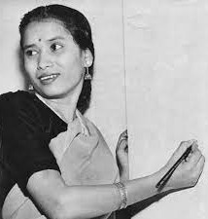
Interesting Facts about the mathematical prodigy
Devi did not like the title of Human-Computer given to her. She stated that the human brain’s ability is far greater than a computer and should never compare both.
In the year 1980, she contested in the election for the parliament seat in two different localities against Indira Gandhi and lost. Devi has been a respected personal astrologer to many politicians, movie stars, and business personnel.
A movie titled “Shakuntala Devi” has been created based on her life. Released in the year 2020, and it showcased the life of Shakuntala Devi and captured her indomitable spirit.

Slide 8
When did Shakuntala Devi die?
Shakuntala Devi’s demise has been a massive loss to the field of mathematics in India. The fantastic journey of mathematical prowess, respected astrologer, inspirational author, and an honorable individual ended on 21st April 2013.

Slide 9
THANK YOU

